Slide 1
Introduction to
Transport Layer

Slide 2
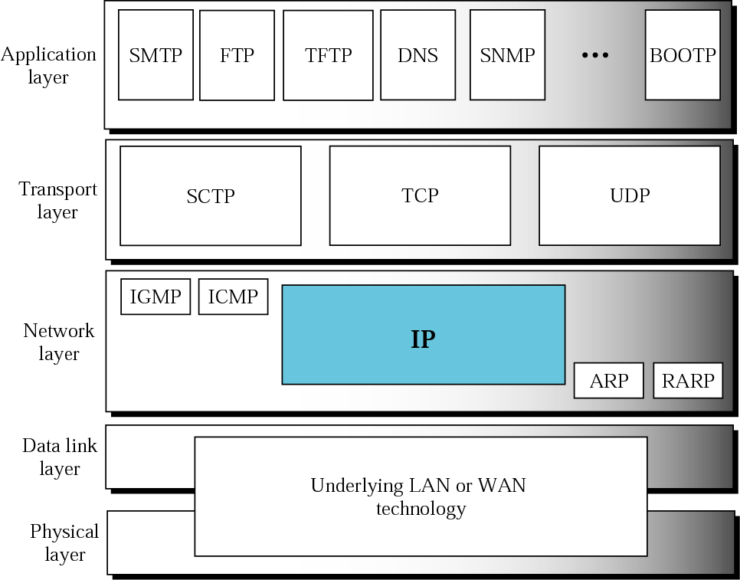

Slide 3
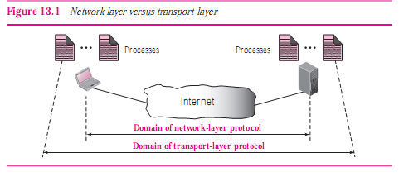
Transport Layer Services
Process-to-Process Communication:

Slide 4
Addressing: Port Numbers
port numbers are integers between 0 and 65,535.
The client program deﬁnes itself with a port number, called the ephemeral port number.
An ephemeral port number is greater than 1,023
TCP/IP has decided to use universal port numbers for servers; these are called well-known port numbers.

Slide 5
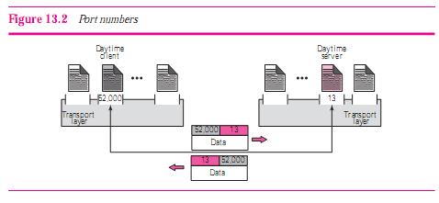

Slide 6
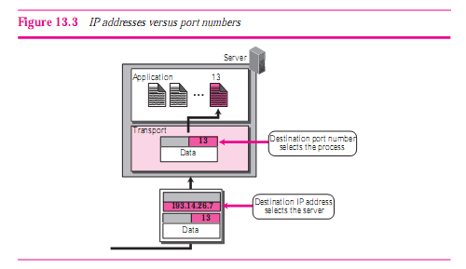

Slide 7
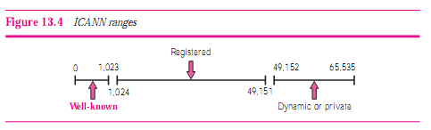
ICANN Ranges
ICANN has divided the port numbers into three ranges: well-known, registered, and dynamic.

Slide 8
Well-known ports :
The ports ranging from 0 to 1,023 are assigned and controlled by ICANN. These are the well-known ports.
Registered ports :
The ports ranging from 1,024 to 49,151 are not assigned or controlled by ICANN. They can only be registered with ICANN to prevent duplication.
Dynamic ports :
The ports ranging from 49,152 to 65,535 are neither controlled nor registered. They can be used as temporary or private port numbers. The original recommendation was that the ephemeral port numbers for clients be chosen from this range. However, most systems do not follow this recommendation.

Slide 9
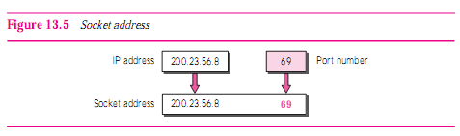
Socket Addresses
The combination of an IP address and a port number is called a Socket Address.

Slide 10
Encapsulation and Decapsulation
To send a message from one process to another, the transport layer protocol encapsulates and decapsulates messages.
Encapsulation : at the sender site. When a process has a message to send, it passes the message to the transport layer along with a pair of socket addresses and some other Info.
Decapsulation : at the receiver site. When the message arrives at the destination transport layer, the header is dropped and the transport layer delivers the message to the process running at the application layer.

Slide 11
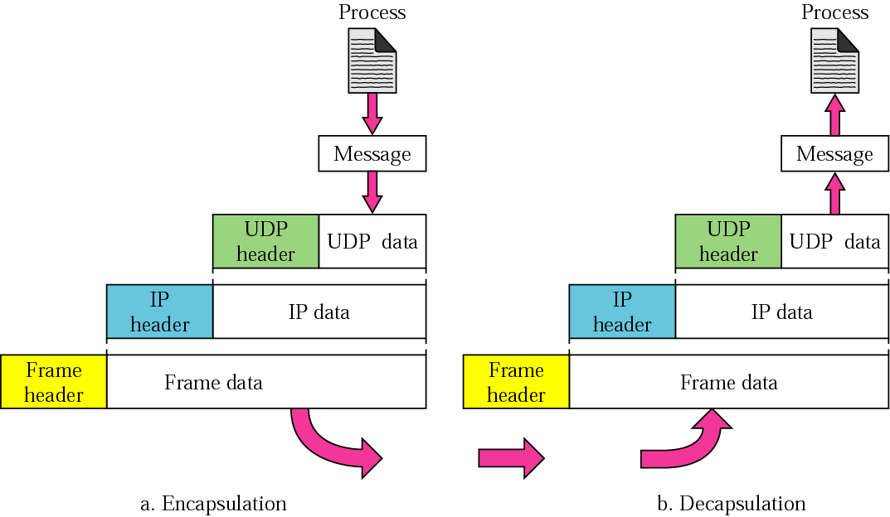
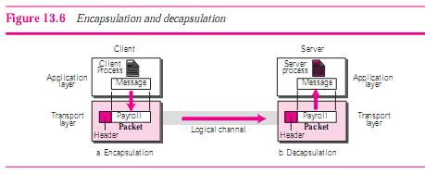

Slide 12
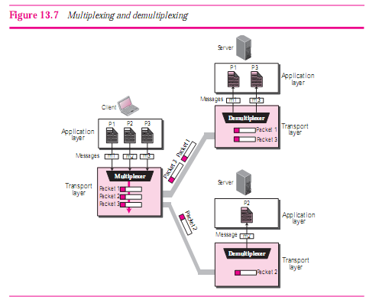
Multiplexing and Demultiplexing

Slide 13
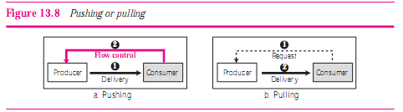
Pushing or Pulling

Slide 14
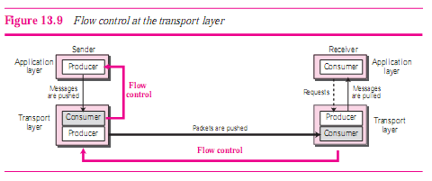
Flow Control at Transport Layer

Slide 15
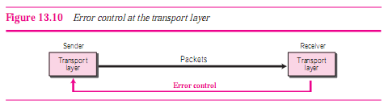
Error Control
Error control at the transport layer is responsible to:
Detect and discard corrupted packets.
Keep track of lost and discarded packets and resend them.
Recognize duplicate packets and discard them.
Buffer out-of-order packets until the missing packets arrive.

Slide 16

Sequence Numbers:
Acknowledgment:

Slide 17
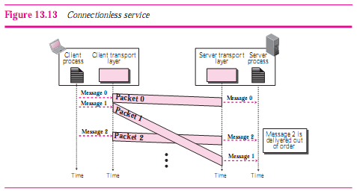
Connectionless and Connection-Oriented Services
Connectionless Service:

Slide 18
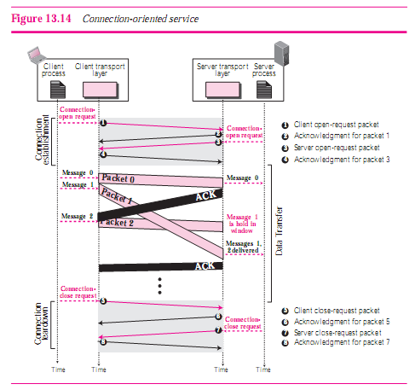
Connection-Oriented Service:

Slide 19
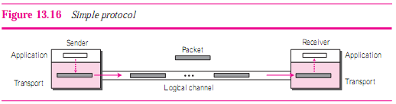
TRANSPORT-LAYER PROTOCOLS
Simple Protocol :

Slide 20
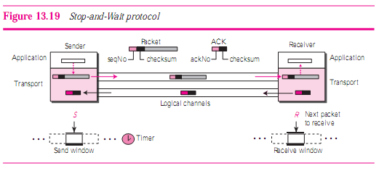

Stop-and-Wait Protocol:

Slide 21
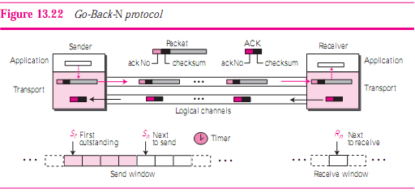
Go-Back-N Protocol

Slide 22
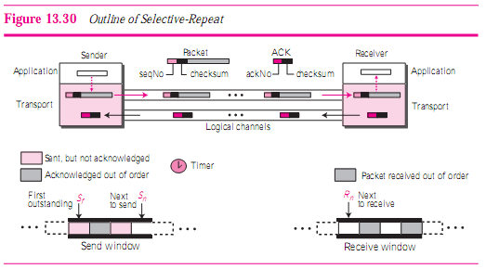

Selective-Repeat Protocol

Slide 23
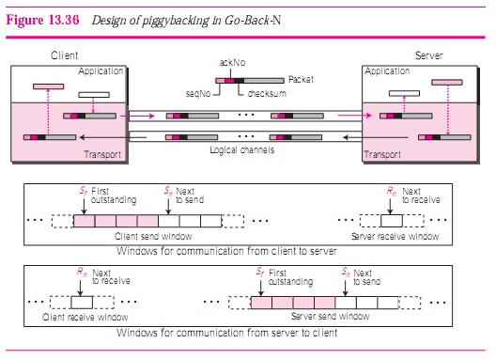
Bidirectional Protocols: Piggybacking

